Slide 1

Day 1: Introduction to Spatial Data Analysis
Dr Anwar Musah (a.musah@ucl.ac.uk)
Lecturer in Social and Geographic Data Science
UCL Geography
1

Slide 2
Structure of this session
Today’s Lecture
An introduction to what Spatial Data Analysis is, and scientific (or geographically) theory the area is grounded on
What are the different types of spatial data, and their features
What are the common spatial analytical techniques
Using RStudio as a GIS
Schedule
Wednesday 17th (15:45-17:00): Lecture – Introduction to Spatial Data Analysis
Thursday 18th (11:00-12:30): Practical on Spatial Data Analysis in RStudio (Part 1)
Friday 19th (14:00-15:30): Practical on Spatial Data Analysis in RStudio (Part 2)
The goal of the practical is to introduce to RStudio and get you to generate maps in a programmatic way as opposed to the point-and-click approach
2
Notes:
This is the overarching structure of the course

Slide 3
What is Spatial Data Analysis?
3

Slide 4
Definition:
The field of Spatial Statistics (or Analysis) is built on the assertation that nearby geographical observations (or objects) are somewhat associated in someway in space.
The field is interdisciplinary as it brings to together theories from statistics, geography, computer science and integrates evidence-based research methodologies (i.e., study designs)
Usage for describing spatial distribution of areal/point/gridded outcomes, as well as interactions between objects in space, but also how an object has an impact on other nearby objects in geographic space.
4

Slide 5

First Law of Geography [1]
Waldo Rudolph Tobler (1930 – 2018)
Tobler’s First Law of Geography on “everything is related to everything else, but near things are more related to distant things”
This first law is the foundation of the fundamental concepts of spatial dependence. It is integrated to most of the families of models in spatial statistics
Very important concepts to keep in mind when you think about spatial dependence:
Spatial Autocorrelation
Distance Decay
Spatial Spillover
5

Slide 6
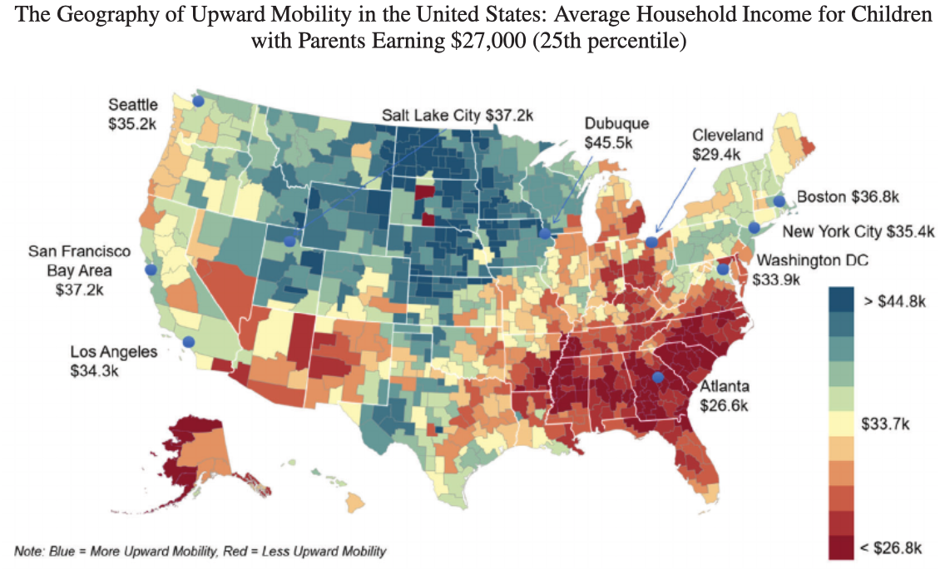
What is Spatial autocorrelation in the context of Tobler’s theory?
“This simply refers to whether (or not) similar values cluster together over geographic space”
Etymology (“Auto” means self; and “correlation” means the degree of relative correspondence)
Similar values that cluster together are said to have positive spatial autocorrelation (& spatially dependent)
Random patterns or values that cluster together are said to have no spatial autocorrelation (and thus no dependence)
Positive
No patterns
Positive
6
Notes:
Areas being related to each other – having similar values

Slide 7
What is Distance decay in the context of Tobler’s theory?
“This refers to the distance between two events (or objects) and their degree of interaction in space as distance vary.”
In short, what distance decay (in the context of Tobler’s theory) says:
It dictates how objects interact. The larger the distance between two events in a space – the less is their interaction & vice versa
Examples of where Distance decay manifests in studies cities and urban space:
As distance from the focal point of a city center increases – high population density, taller buildings, and accessibility to multiple modes of transport decreases
Housing marketing – house prices decreases, and in turn, residential mobility increases from expensive to affordable areas
7
Notes:
Distance

Slide 8
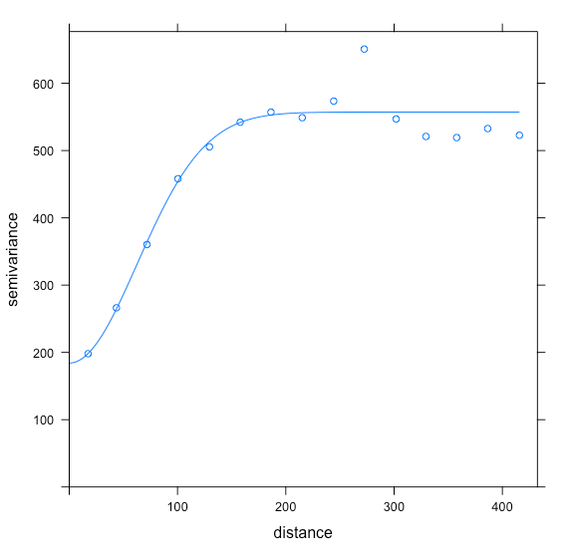
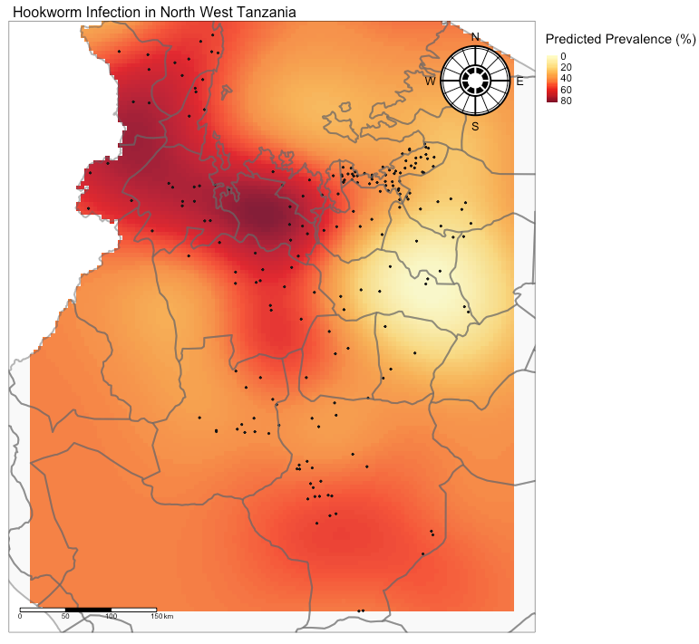
Using Kriging to spatially predict areas with intense hookworm infection associated with socioeconomic deprivation in Northwestern Tanzania
Below 180km
Over 180km
Villages with hookworm
prevalence with separation
distance below 180km have similar prevalence
Villages with hookworm
prevalence with separation
distance 180km and over don’t
have related prevalence
We have survey points (of villages) reporting prevalence of hookworm in Northwestern Tanzania. We assumed there some spatial dependence in the prevalence of hookworm in these locations to predict prevalence where there are no information (or points). We use this information on form the left panel to build our model for making geostatistical predictions.
We used the concept of distance decay, or in this
‘separation distance’ to account for spatial dependence
between our survey points
8

Slide 9
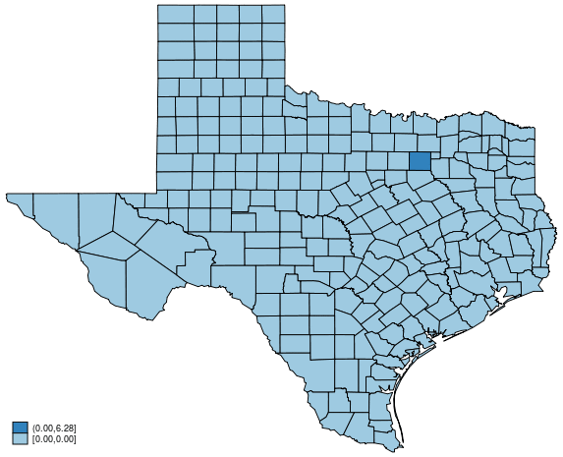
Spatial Spillover: “…where you are in geographic space matters” an event in one location can someway have an impact on other events in neighboring areas
In Spatial Statistics, especially in Spatial Regression, Geostatistics – we often try to account for spatial spillover effects in our models
There are four types of spillovers:
No spillover
Local spillover
Global spillover
Rippling spillovers
9

Slide 10
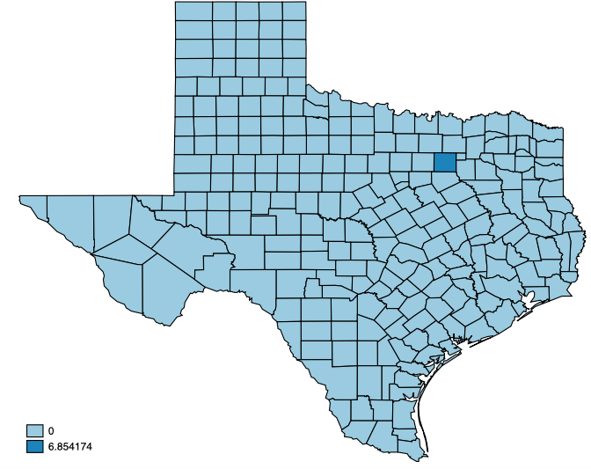
Spatial Spillover: “…where you are in geographic space matters” an event in one location can someway have an impact on other events in neighboring areas
In Spatial Statistics, especially in Spatial Regression, Geostatistics – we often try to account for spatial spillover effects in our models
No spillover (independence)
A change in unemployment in that dark blue area will only have an impact on crime rates within its own area, but does not influence crime rates in neighboring areas
10

Slide 11
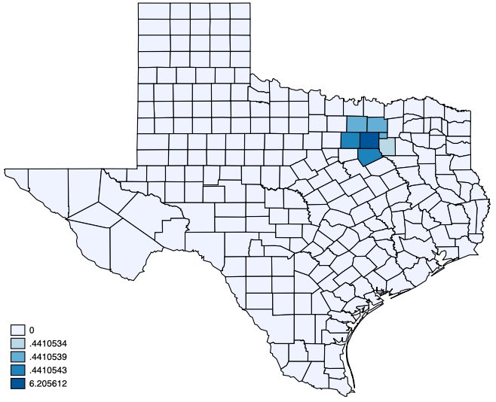
Spatial Spillover: “…where you are in geographic space matters” an event in one location can someway have an impact on other events in neighboring areas
In Spatial Statistics, especially in Spatial Regression, Geostatistics – we often try to account for spatial spillover effects in our models
Local spillover (dependence)
A change in unemployment in that dark blue area (in the center) will not only have an impact on crime rates within its own area, but it will also have a direct influence on crime rates in neighboring areas only.
11

Slide 12
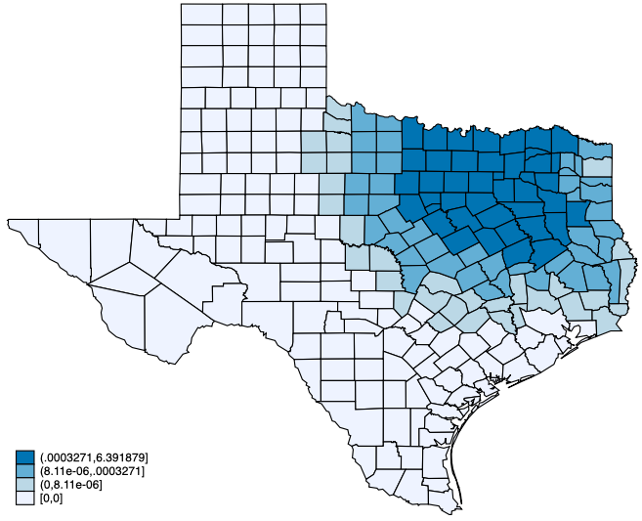
Spatial Spillover: “…where you are in geographic space matters” an event in one location can someway have an impact on other events in neighboring areas
In Spatial Statistics, especially in Spatial Regression, Geostatistics – we often try to account for spatial spillover effects in our models
Global spillover (dependence)
A change in unemployment in that dark blue area (in the center) will not only have an impact on crime rates within its own area, but it will also have a wider influence on crime rates beyond its direct neighbors.
12

Slide 13
Spatial Spillover: “…where you are in geographic space matters” an event in one location can someway have an impact on other events in neighboring areas
In Spatial Statistics, especially in Spatial Regression, Geostatistics – we often try to account for spatial spillover effects in our models
Rippling spillover (dependence)
Where there is a focal point for an event and its influence may have a rippling (or trickle down) effect across space, triggering other events, which then diminishes with time and distance.
e.g.,
Natural disasters - an earthquake and building destruction.
Disease spread and outbreaks
World financial markets and crashes
13

Slide 14
What is Spatial Data & its Features?
14
Notes:
Spatial data is any entity that has information about its geographic attributes
- There are 3 types of data
1.) Point patterns
2.) Aggregated/Area-based data
3.) Geostatistical data

Slide 15
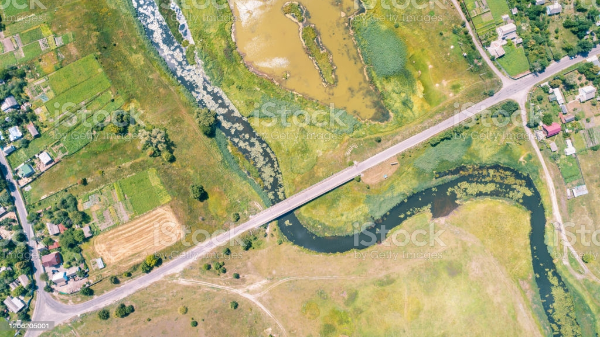
Suppose we want to map the following from this landscape:
1. Physical objects:
Location of buildings
Farm plots
Locations of trees
Road network
Block areas (divided by the road)
2. Levels of soil moisture across the landscape
15
Notes:
Suppose, we want to create a digital map by capturing 2 major things from this landscape:
Physical objects such as….
And we want to display the levels of soil moisture across this entire landscape
Let us expand this image a bit and focus on the physical objects.

Slide 16
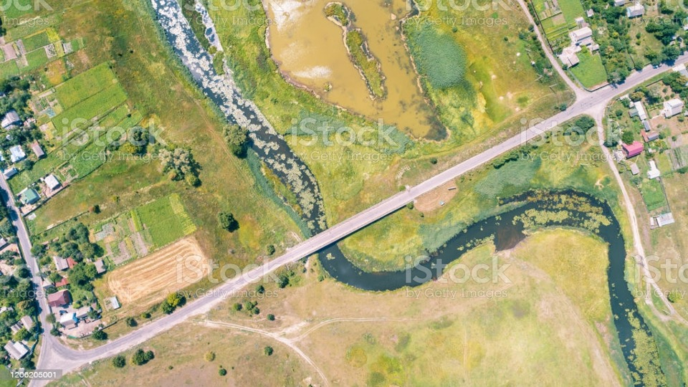
Individual buildings
Road network
Land-use plots (Farm)
Area blocks (partitioned by the roads)
Individual trees
16
Notes:
Suppose we take this image and load it into a GIS software such as QGIS and ArcGIS, where we try to directly extract these
physical objects in the shaded region,
as well as the block areas formed from the road network
And the road network
from the landscape image…

Slide 17
Individual buildings
Road network
Land-use plots (Farms)
Area blocks (partitioned by the roads)
Individual trees
17
Notes:
When we digitise these physical objects i.e., buildings, trees, roads, river stream & land-use
We derive something which we call a ‘spatial feature’
When we remove this landscape image…

Slide 18
Individual buildings
Road network
Land-use plots (Farms)
Area blocks (partitioned by the roads)
Individual trees
18
Notes:
This is what these spatial features will typically by displayed like this in any GIS software.
Now, we can describe these features with some text or numerical information called “attribute”.
We have two keywords: Spatial Feature (or Feature) and Attribute.

Slide 19
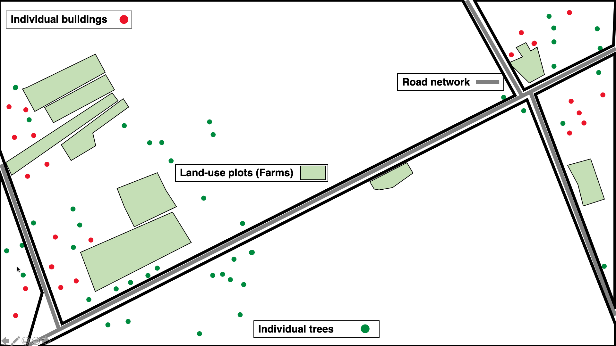
Individual buildings
Individual trees
Road network
Land-use plots (Farms)
Area block
The above objects listed are called “Features”. A feature can be described according to its characteristics which is termed an “Attribute” in GIS. The attribute of a feature can be a numeric or text observation.
For example:
A building is a point feature on this map, the number of people living a building is a numeric attribute describing this feature. Type of building (i.e., Victorian or modern) is a text attribute
The road network is a polyline feature, the length (or distance (m)) of the road is a numeric attribute describing the road
Land-use plot is a polygon (or area) feature, the type of land-use (i.e., farming) is the text attribute describing what that polygon is etc.
19

Slide 20
What about the soil moisture
20

Slide 21
6 | 7 | 8 | 10 | 0 | 0 | 10 | 10 | 0 | 0 | 0 | 0 | 10 | 5 | 3 | 0 | 0 | 0 | 0 | 0
6 | 7 | 8 | 10 | 0 | 0 | 10 | 10 | 0 | 0 | 10 | 0 | 10 | 6 | 3 | 0 | 0 | 0 | 0 | 0
6 | 7 | 8 | 10 | 10 | 0 | 10 | 10 | 0 | 0 | 10 | 0 | 10 | 7 | 5 | 3 | 0 | 0 | 0 | 0
5 | 6 | 8 | 9 | 10 | 10 | 0 | 10 | 0 | 0 | 10 | 0 | 10 | 7 | 5 | 3 | 0 | 0 | 0 | 0
1 | 4 | 8 | 9 | 9 | 10 | 0 | 10 | 10 | 10 | 0 | 0 | 0 | 7 | 5 | 3 | 0 | 0 | 0 | 0
0 | 4 | 8 | 9 | 9 | 10 | 10 | 0 | 10 | 9 | 9 | 0 | 0 | 5 | 3 | 0 | 0 | 0 | 0 | 0
0 | 4 | 8 | 8 | 9 | 9 | 10 | 0 | 0 | 9 | 8 | 7 | 5 | 0 | 0 | 0 | 1 | 0 | 0 | 0
0 | 3 | 5 | 8 | 8 | 9 | 10 | 10 | 0 | 9 | 7 | 5 | 0 | 0 | 5 | 5 | 5 | 0 | 0 | 0
0 | 0 | 3 | 5 | 8 | 9 | 9 | 10 | 0 | 0 | 3 | 0 | 0 | 0 | 5 | 0 | 0 | 1 | 0 | 0
0 | 2 | 2 | 5 | 8 | 8 | 9 | 9 | 10 | 0 | 0 | 0 | 1 | 5 | 0 | 0 | 0 | 0 | 0 | 0
0 | 2 | 2 | 4 | 6 | 8 | 8 | 9 | 0 | 0 | 0 | 1 | 5 | 0 | 0 | 5 | 5 | 5 | 0 | 0
0 | 0 | 0 | 3 | 6 | 8 | 8 | 0 | 0 | 0 | 0 | 5 | 0 | 5 | 5 | 5 | 5 | 5 | 0 | 0
0 | 0 | 2 | 2 | 5 | 8 | 0 | 0 | 0 | 0 | 0 | 0 | 5 | 5 | 5 | 5 | 5 | 5 | 3 | 0
0 | 0 | 0 | 2 | 5 | 0 | 0 | 1 | 2 | 3 | 4 | 4 | 4 | 4 | 4 | 4 | 4 | 5 | 0 | 0
0 | 0 | 0 | 0 | 0 | 0 | 1 | 1 | 1 | 1 | 4 | 4 | 4 | 4 | 4 | 4 | 4 | 5 | 0 | 0
0 | 0 | 0 | 0 | 1 | 1 | 2 | 2 | 2 | 2 | 3 | 3 | 3 | 3 | 3 | 3 | 3 | 4 | 0 | 3
0 | 0 | 1 | 1 | 1 | 1 | 2 | 2 | 3 | 3 | 3 | 3 | 3 | 3 | 3 | 3 | 3 | 4 | 0 | 3
Amount of moisture in soil at any of spot in these rectangle pixels to see change in gradient
Notes:
Continuous information for any spot you see in these grids e.g., amount of rainfall
How do we translate these into spatial data?

Slide 22
6 | 7 | 8 | 10 | 0 | 0 | 10 | 10 | 0 | 0 | 0 | 0 | 10 | 5 | 3 | 0 | 0 | 0 | 0 | 0
6 | 7 | 8 | 10 | 0 | 0 | 10 | 10 | 0 | 0 | 10 | 0 | 10 | 6 | 3 | 0 | 0 | 0 | 0 | 0
6 | 7 | 8 | 10 | 10 | 0 | 10 | 10 | 0 | 0 | 10 | 0 | 10 | 7 | 5 | 3 | 0 | 0 | 0 | 0
5 | 6 | 8 | 9 | 10 | 10 | 0 | 10 | 0 | 0 | 10 | 0 | 10 | 7 | 5 | 3 | 0 | 0 | 0 | 0
1 | 4 | 8 | 9 | 9 | 10 | 0 | 10 | 10 | 10 | 0 | 0 | 0 | 7 | 5 | 3 | 0 | 0 | 0 | 0
0 | 4 | 8 | 9 | 9 | 10 | 10 | 0 | 10 | 9 | 9 | 0 | 0 | 5 | 3 | 0 | 0 | 0 | 0 | 0
0 | 4 | 8 | 8 | 9 | 9 | 10 | 0 | 0 | 9 | 8 | 7 | 5 | 0 | 0 | 0 | 1 | 0 | 0 | 0
0 | 3 | 5 | 8 | 8 | 9 | 10 | 10 | 0 | 9 | 7 | 5 | 0 | 0 | 5 | 5 | 5 | 0 | 0 | 0
0 | 2 | 3 | 5 | 8 | 9 | 9 | 10 | 0 | 0 | 3 | 0 | 0 | 0 | 5 | 0 | 0 | 1 | 0 | 0
0 | 2 | 2 | 5 | 8 | 8 | 9 | 9 | 10 | 0 | 0 | 0 | 1 | 5 | 0 | 0 | 0 | 0 | 0 | 0
0 | 2 | 2 | 4 | 6 | 8 | 8 | 9 | 0 | 0 | 0 | 1 | 5 | 0 | 0 | 5 | 5 | 5 | 0 | 0
0 | 0 | 2 | 3 | 6 | 8 | 8 | 0 | 0 | 0 | 0 | 5 | 0 | 5 | 5 | 5 | 5 | 5 | 0 | 0
0 | 0 | 2 | 2 | 5 | 8 | 0 | 0 | 0 | 0 | 0 | 0 | 5 | 5 | 5 | 5 | 5 | 5 | 3 | 0
0 | 0 | 0 | 2 | 5 | 0 | 0 | 1 | 2 | 3 | 4 | 4 | 4 | 4 | 4 | 4 | 4 | 5 | 0 | 0
0 | 0 | 0 | 0 | 0 | 0 | 1 | 1 | 1 | 1 | 4 | 4 | 4 | 4 | 4 | 4 | 4 | 5 | 0 | 0
0 | 0 | 0 | 0 | 1 | 1 | 2 | 2 | 2 | 2 | 3 | 3 | 3 | 3 | 3 | 3 | 3 | 4 | 0 | 3
0 | 0 | 1 | 1 | 1 | 1 | 2 | 2 | 3 | 3 | 3 | 3 | 3 | 3 | 3 | 3 | 3 | 4 | 0 | 3
Soil moisture index
 | 10
 | 7 to 9
 | 4 to 6
 | 1 to 3
 | 0
Unlike the vector data. The above feature describes how moisture levels across the surface of the landscape – the feature is is not measured discretely but on a continuous surface to show gradient in changes for soil moisture across the landscape
Now, this Non-discrete feature is classed a Raster Data
What is Raster Data?
It is a matrix of pixels or grid-cells that contains a numeric or text value for a feature its representing
It is composed of rows and columns
Each pixel or grid-cell has a resolution (or size for height and width)
22
Notes:
Here is a bird’s eye view of a location.
Let’s say that we want to make a map of this piece of landscape – and we wanted to map the following things –

Slide 23
6 | 7 | 8 | 10 | 0 | 0 | 10 | 10 | 0 | 0 | 0 | 0 | 10 | 5 | 3 | 0 | 0 | 0 | 0 | 0
6 | 7 | 8 | 10 | 0 | 0 | 10 | 10 | 0 | 0 | 10 | 0 | 10 | 6 | 3 | 0 | 0 | 0 | 0 | 0
6 | 7 | 8 | 10 | 10 | 0 | 10 | 10 | 0 | 0 | 10 | 0 | 10 | 7 | 5 | 3 | 0 | 0 | 0 | 0
5 | 6 | 8 | 9 | 10 | 10 | 0 | 10 | 0 | 0 | 10 | 0 | 10 | 7 | 5 | 3 | 0 | 0 | 0 | 0
1 | 4 | 8 | 9 | 9 | 10 | 0 | 10 | 10 | 10 | 0 | 0 | 0 | 7 | 5 | 3 | 0 | 0 | 0 | 0
0 | 4 | 8 | 9 | 9 | 10 | 10 | 0 | 10 | 9 | 9 | 0 | 0 | 5 | 3 | 0 | 0 | 0 | 0 | 0
0 | 4 | 8 | 8 | 9 | 9 | 10 | 0 | 0 | 9 | 8 | 7 | 5 | 0 | 0 | 0 | 1 | 0 | 0 | 0
0 | 3 | 5 | 8 | 8 | 9 | 10 | 10 | 0 | 9 | 7 | 5 | 0 | 0 | 5 | 5 | 5 | 0 | 0 | 0
0 | 2 | 3 | 5 | 8 | 9 | 9 | 10 | 0 | 0 | 3 | 0 | 0 | 0 | 5 | 0 | 0 | 1 | 0 | 0
0 | 2 | 2 | 5 | 8 | 8 | 9 | 9 | 10 | 0 | 0 | 0 | 1 | 5 | 0 | 0 | 0 | 0 | 0 | 0
0 | 2 | 2 | 4 | 6 | 8 | 8 | 9 | 0 | 0 | 0 | 1 | 5 | 0 | 0 | 5 | 5 | 5 | 0 | 0
0 | 0 | 2 | 3 | 6 | 8 | 8 | 0 | 0 | 0 | 0 | 5 | 0 | 5 | 5 | 5 | 5 | 5 | 0 | 0
0 | 0 | 2 | 2 | 5 | 8 | 0 | 0 | 0 | 0 | 0 | 0 | 5 | 5 | 5 | 5 | 5 | 5 | 3 | 0
0 | 0 | 0 | 2 | 5 | 0 | 0 | 1 | 2 | 3 | 4 | 4 | 4 | 4 | 4 | 4 | 4 | 5 | 0 | 0
0 | 0 | 0 | 0 | 0 | 0 | 1 | 1 | 1 | 1 | 4 | 4 | 4 | 4 | 4 | 4 | 4 | 5 | 0 | 0
0 | 0 | 0 | 0 | 1 | 1 | 2 | 2 | 2 | 2 | 3 | 3 | 3 | 3 | 3 | 3 | 3 | 4 | 0 | 3
0 | 0 | 1 | 1 | 1 | 1 | 2 | 2 | 3 | 3 | 3 | 3 | 3 | 3 | 3 | 3 | 3 | 4 | 0 | 3
Vector data
Raster data
These are discrete spatial data that are stored as a shapefile format (.shp)
These are continuous gridded spatial data that are stored as a GEOTIFF format (.tiff)
23

Slide 24
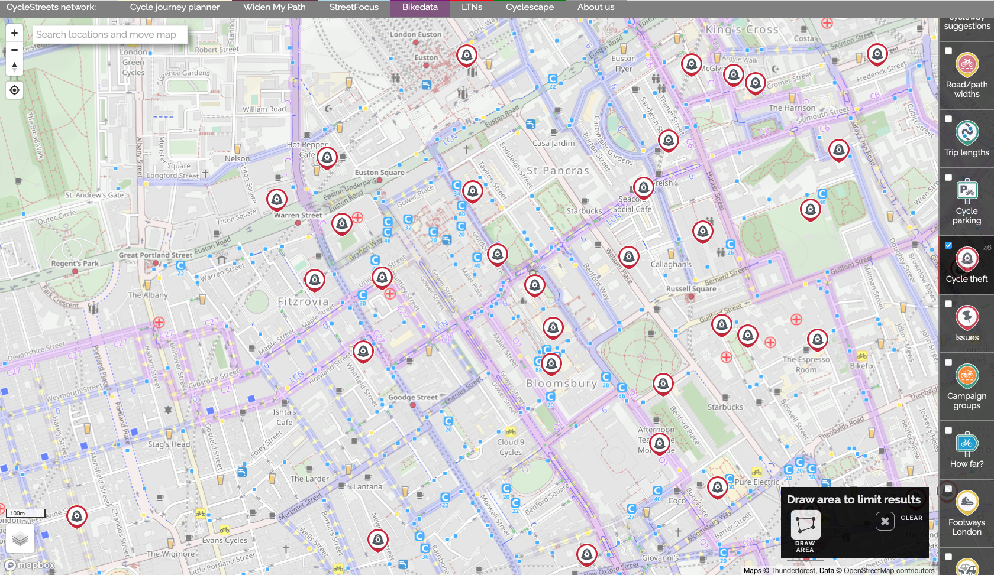
Point Pattern Data (PPD)
Key Characteristics
The main interest is the occurrences of an event at a points (or points). These events occur at “random” at any given geographic space and time.
Examples of PPDs events (or outcomes):
Point locations of burglaries
Riots
Locations of car collisions etc.,
Locations of where an adult tree needs to be replanted
Some PPDs events may carry additional information that may describe the occurrence of an observed event (or outcome):
Burglary: Type of premise that was burgled, time of day the burglary occurred etc.,
Car collision: type of road, weather condition etc.
Represents point locations of bicycle thefts in Central London area
Source: BikeData.CycleStreets network https://bikedata.cyclestreets.net/
24

Slide 25
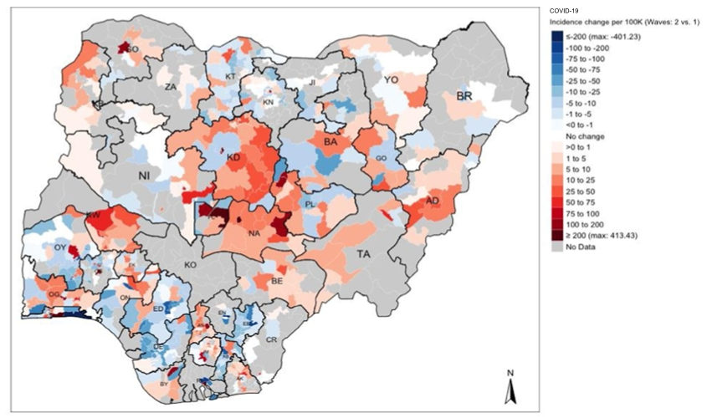
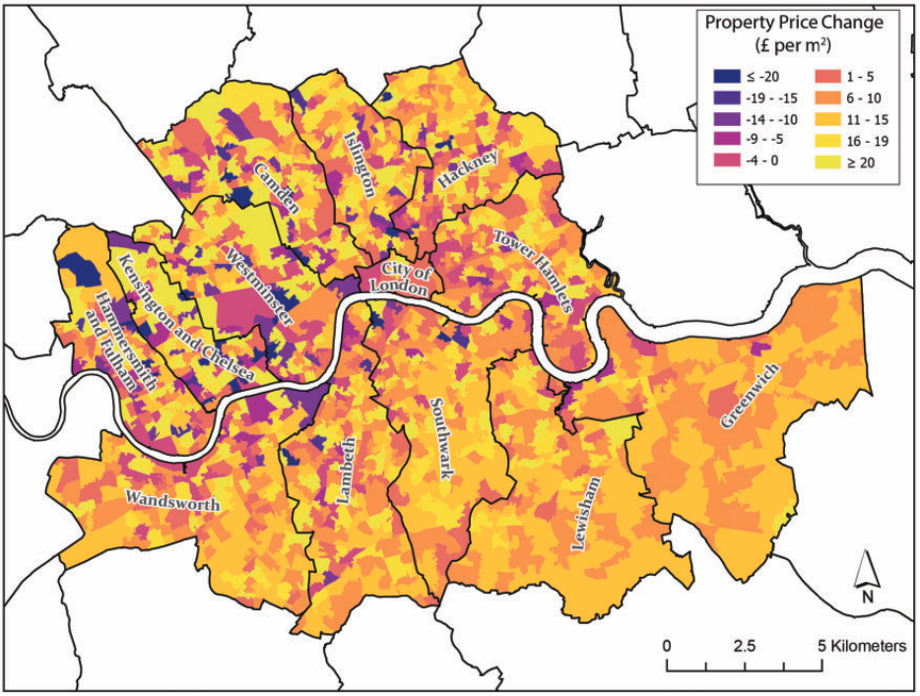
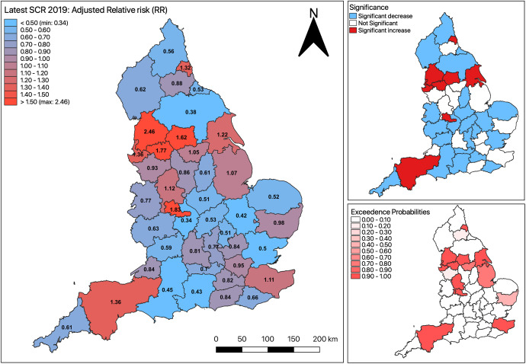
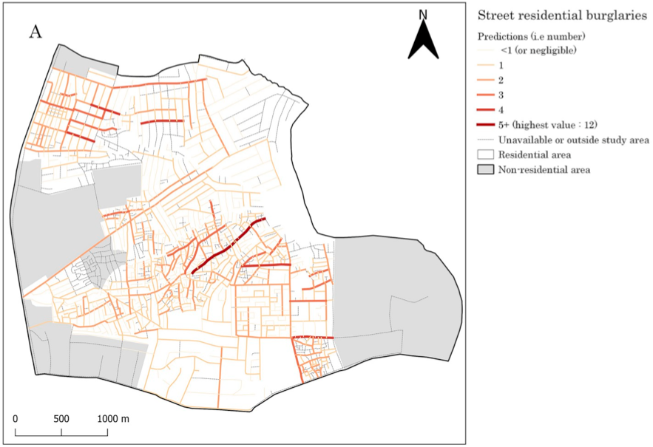
Aggregated Data
Key Characteristics
The main interest the quantity of interest defined for line segments, areas, or regions.
Events (or outcomes) that are aggregated measures to areas:
Prevalence of a disease in areas
Population density in a county
Regional unemployment rates
Risk of an outcome
Sources:
Musah, A., et al. (2020): https://doi.org/10.1016/j.apgeog.2019.102126
Todd, J., et al. (2021): https://doi.org/10.1177/23998083211001836
Li, L., et al. (2022): https://doi.org/10.1016/j.apgeog.2022.102718
Elimian, K., et al. (2022): http://dx.doi.org/10.1136/bmjopen-2022-063703
25

Slide 26
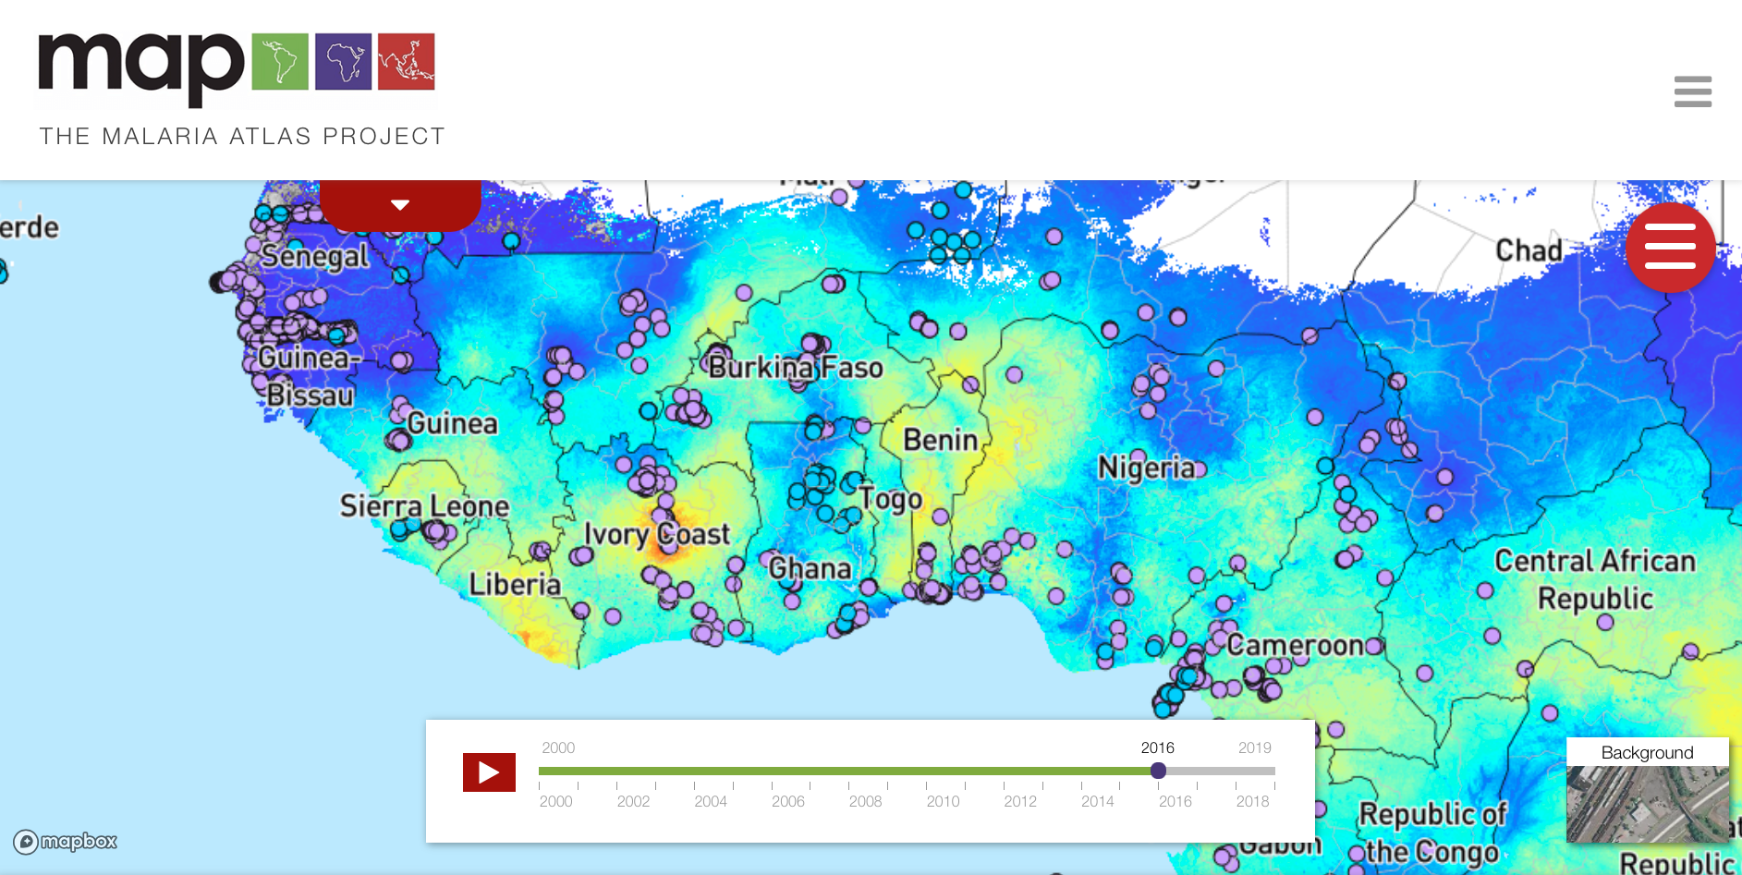
Geostatistical Data
Key Characteristics
The quantity of interest has a value at any location across a given area.
These are values over a grid/raster
Events are usual statistical prediction determined from “sampled” points with continuous data values:
Land surface elevation
Diffusion of ambient air pollutants
Environmental suitability for breeding habitats of mosquitoes
Community surveys pertained to disease burden
Sampled points are surveys on prevalence of malaria, which were used to make survey predication of prevalence at unsampled areas in Sub-Saharan Africa
Source: The Malaria Atlas Project https://malariaatlas.org
26

Slide 27
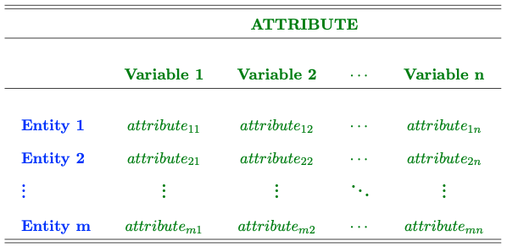
Non-spatial context & data structure:
Attributes that defines an entity’s location are typically excluded from the analysis
The conventional statistical methods, that assumes independence, are used for analyzing such dataset
Results churned from this dataset are completely independent from “spatial arrangement” of the entities.
To apply some spatial analysis to data – you must have some variable that defines the entity’s geographic location. This can be GPS coordinates, spatially referenced geometries of an area
NOTES: It is not enough to have the just the name of the area(s). It must be some geometric entry!
27

Slide 28
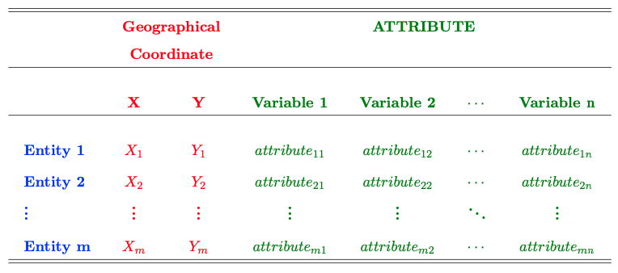
Spatial context & data structure:
Attributes that defines an entity’s location are typically explicitly incorporated into analysis
Spatial statistical methods, that assumes dependence, are used for analyzing such geographically referenced dataset
Results churned from this dataset are completely dependent from “spatial arrangement” of the entities.
In this example, what defines the entity’s geographic location are X, Y GPS coordinates, or some geometry
Definition of an entity’s location are not limited to coordinates, you can have spatially reference areas with their associated boundaries with geometries.
This instance illustrates an example of geostatistical data.
28
Notes:
If area, you will have the area name that defines the geographical entity
If line segment, a series of points connecting to form a line segment that defines the geographical entity etc.

Slide 29
Various Spatial Analytical Techniques
29
Notes:
Spatial data is any entity that has information about its geographic attributes
- There are 3 types of data
1.) Point patterns
2.) Aggregated/Area-based data
3.) Geostatistical data

Slide 30
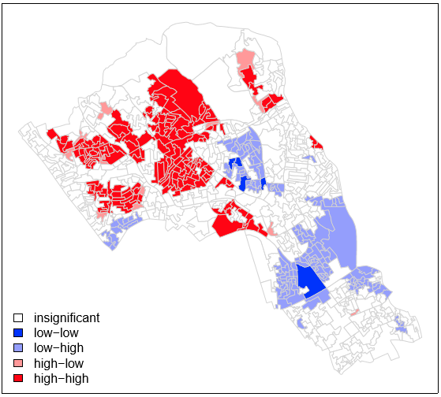
[1] Areal Data: Spatial Autocorrelation & Dependence
Spatial analytical technique used for detecting clusters
of an outcome.
Local Test
Global Test
Generate the hypothesis
Null hypothesis: Are the patterns residential burglaries in Camden (London) are random?
Alternative hypothesis: The patterns of residential burglaries in Camden are not random, and are indeed either spatially clustered, or dispersed.
How to perform Global Moran’s I test to get a p-value to accept, or reject the null hypothesis
Result (Global Moran’s I = 0.5448 [p=0.0001 < 0.05])
This is what we want. The p-values helps us to know whether the LISA estimates are statistically significant or not.
30

Slide 31
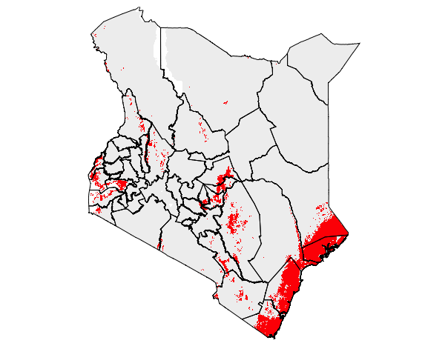
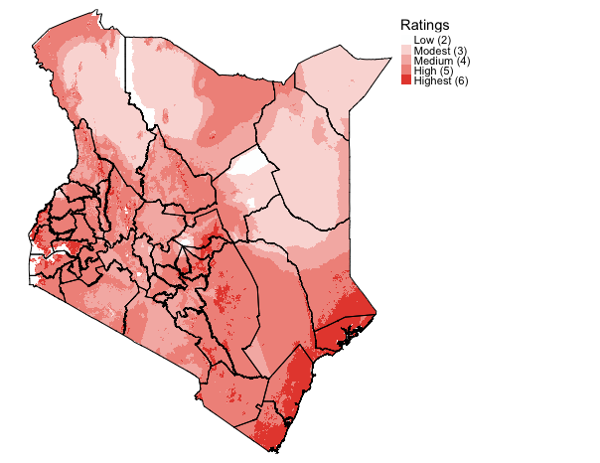
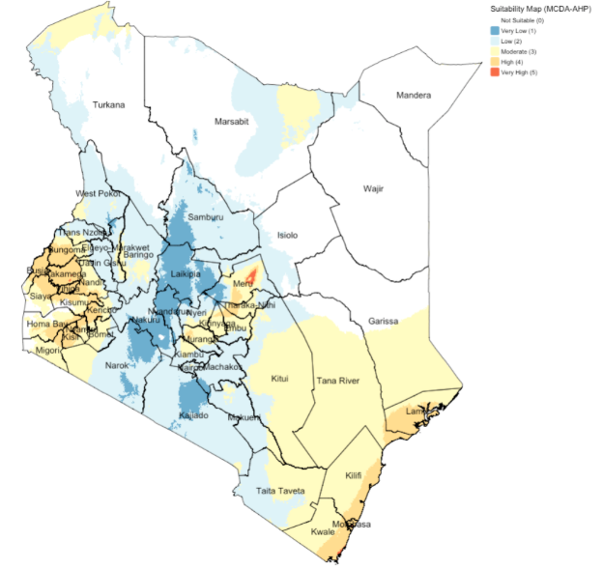
[2] Gridded Data: Multi-Decision Criteria Analysis
Simple Overlays: Booleans & Rankings
Analytical Hierarchy Process
31

Slide 32


CASE STUDY: GIS-MCDA applied to identify suitable areas for Lymphatic Filariasis (LF) transmission in Kenya.
NOTES
Description: There are no available up-to-date models to explain the occurrence of Lymphatic Filariasis (LF) in Kenya and geospatial empirical data are scarce. The Kenyan Ministry of Health (K-MoH), through its LF control programme, is planning to launch a public health intervention by introducing mass drug administration (MDA) of albendazole (combined with ivermectin) to infected people with LF and to remove microfilaria in their bloodstream. Mapping of suspected areas for LF must be carried out, however, due to financial constraints and limited resources, the K-MoH wishes to first identify areas that are highly suitable for LF transmission before spending this limited resources to survey, map and apply MDAs to these areas.
African man with heavy & chronic LF microfilaria infection, resulting in a swollen leg called ‘Elephantiasis’
One many vectors, i.e., the Culex mosquito, that spreads LF by injecting microfilaria (microscopic worms) into their source of food (i.e., human) before taking its bloodmeal
32

Slide 33
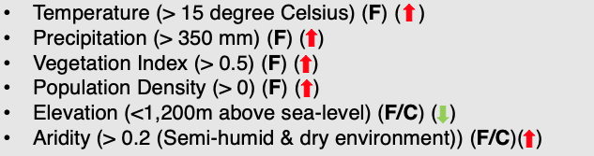
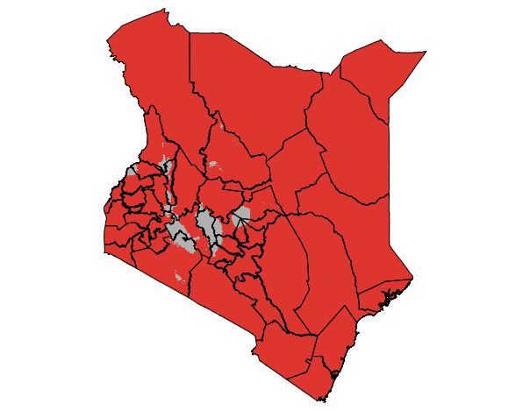
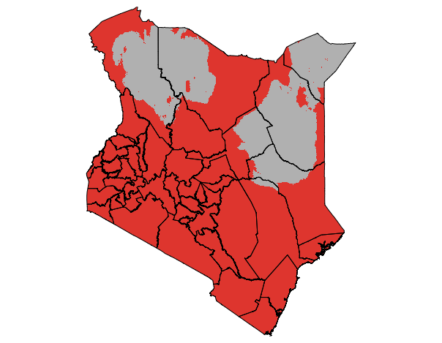
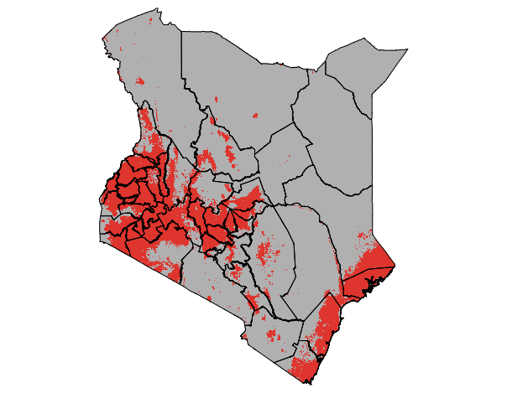
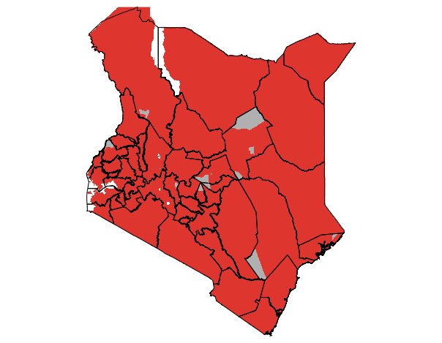
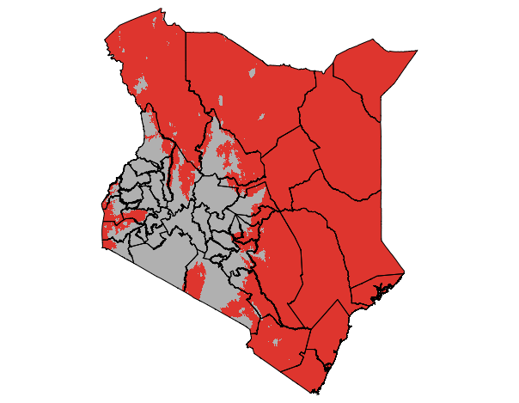
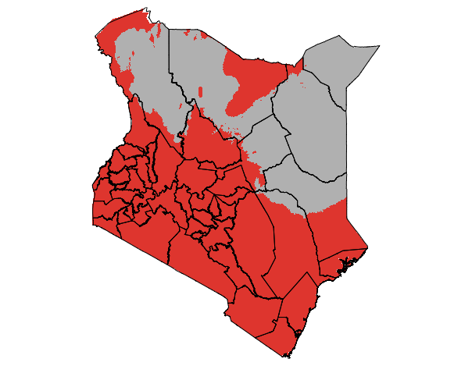





[a] Binary (or Boolean) maps with the factor layers
Binary suitability is determined simply by multiplying the six individual layers that were reclassified to 0’s and 1’s.
NOTES
We have these data as raster – for this approach requires simply reclassification of the data into binary raster and multiplication
e.g., if temperature > 15 then change pixel value to 1 (good condition), else change to zero (bad condition)
$$×$$
$$×$$
$$×$$
$$×$$
$$×$$
$$=$$
33

Slide 34
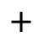
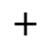
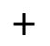
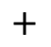
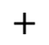
[b] Rankings/Ratings maps with the factor layers
The ratings or suitability scores are determined simply by summing the values across the six individual layers that where reclassified (minimum value = 2, and maximum = 6).
NOTES
We have these data as raster – for this approach requires simply reclassification of the data into binary raster and summation to get scores
e.g., if temperature > 15 then change pixel value to 1 (good condition), else change to zero (bad condition)
$$+$$
$$+$$
$$+$$
$$+$$
$$+$$
$$=$$
34

Slide 35
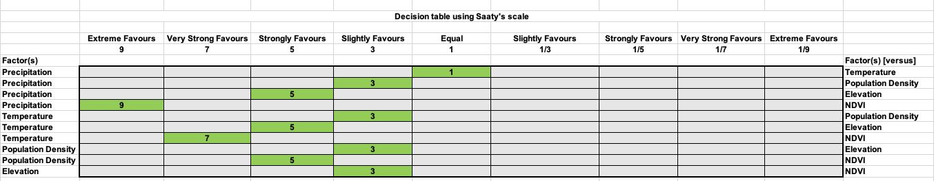
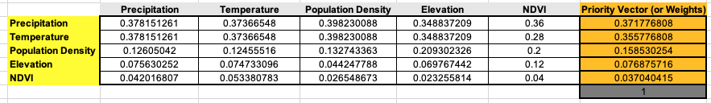
[c] Analytical Hierarchy Process (AHP)
This involves building a decision table based on expert opinion
Resulting Map from Decisions
Priority weight matrix is generated from the decision table
This is used to build the equation to make the prediction about where LF is in Kenya
35

Slide 36
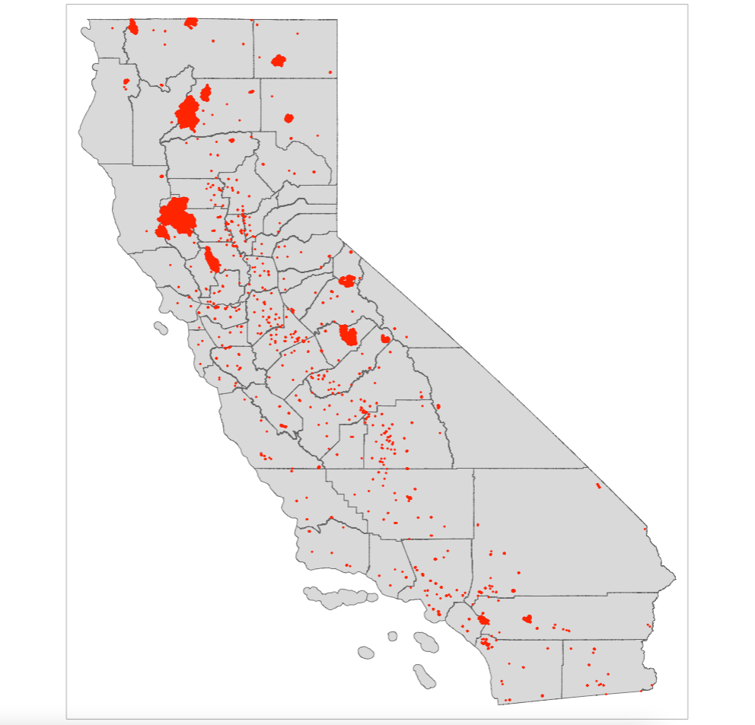
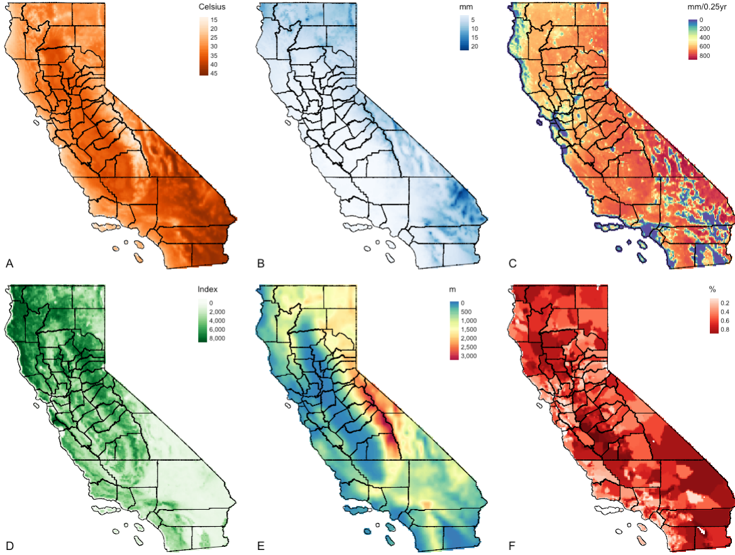
[3] Point Pattern Process: Ecological Niche Models
The social side of fires: assessing the inclusion of human social factors in fire prediction models
The objectives are to determine the occurrence of wildfires, as well as infer the extent (or zones) for such environmental hazard in California given a set of predictor variables (i.e., climate, vegetation, anthropogenic and socioeconomic risk factors which are raster)
Figure shows the study area of California (counties) and points are occurrence of wildfires during the summer period of 2018. Presence-only points.
Figure panel shows A: Temperature (degree Celsius); B: Precipitation (mm); C: Dryness (Evapotranspiration) (mm/0.25 year); D: Vegetation (NDVI); E: Elevation (meters [m]); & F: Socioeconomic vulnerability index (%)
36

Slide 37
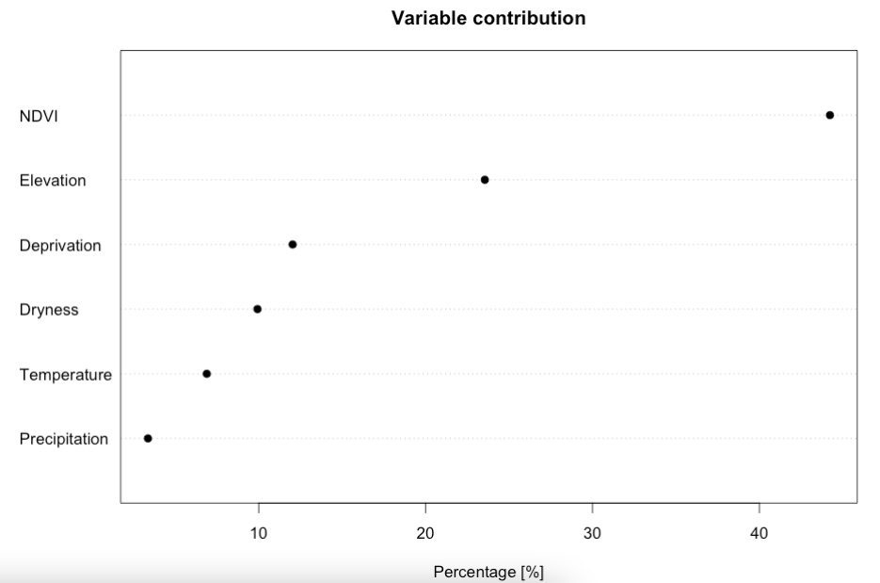
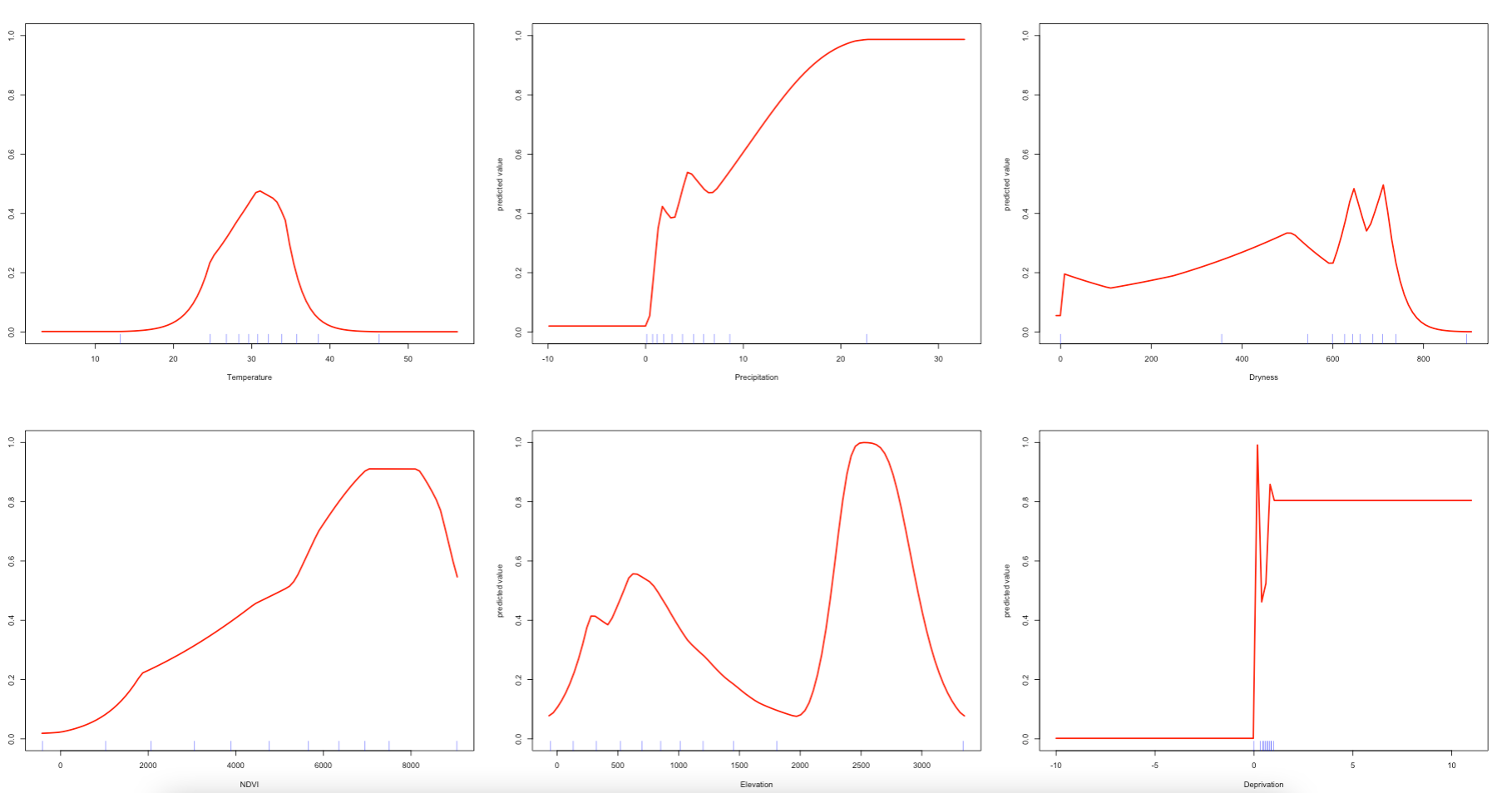
Using MAXENT
Result 1: Variable Contribution & Response curves
Response curves
Interpretation: Here, we can see the following contribution estimates: NDVI (44.2321%); Elevation (23.5530%); Deprivation (12.0339%); Dryness (9.9266); Temperature (6.8892%); and Precipitation (3.3653%). The contribution estimates should sum up to 100%. From this plot, we can see that the model is most sensitive to variation in NDVI, followed with additional contributions from land surface elevation, and from increased levels of socioeconomic deprivation (reporting top three).
Figure panel shows from top left: Temperature (degree Celsius); Precipitation (mm); Dryness (Evapotranspiration) (mm/0.25 year); Vegetation (NDVI); Elevation (meters [m]); & Socioeconomic vulnerability index (%)
Interpretation: In the response plots, we are looking at how the probability of fire occurrence (Y-axes, from zero to one) varies with each the environmental predictors (X-axes). From these plots, we can see that the MAXENT models can include complex environmental responses including plateau, linear, and nonlinear shapes, and some which are utterly unclear. For example, if we look at mean temperature during the summer, we can see that the probability for fire occurrence peaks around 0.60 when temperatures are around 30 degrees Celsius. We can also see that the probability of such outcome increases with more and more vegetation during the summer period. Probability in terms of fires in relation to deprivation is a flat line. For precipitation, dryness and elevation - the patterns are unclear.
37

Slide 38
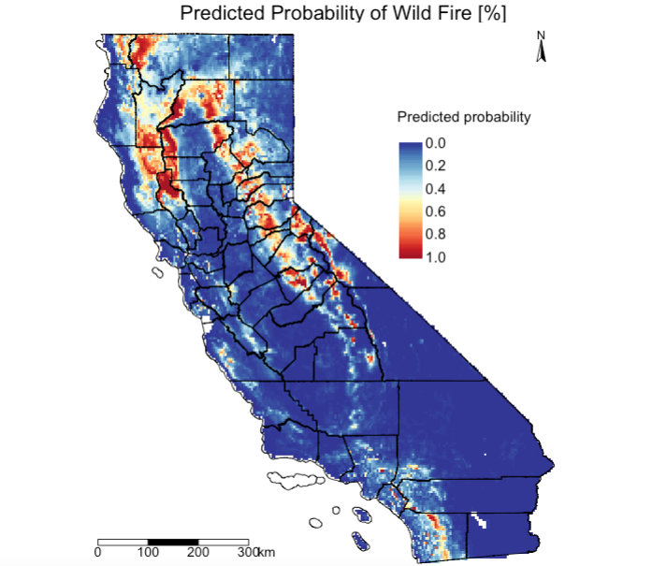
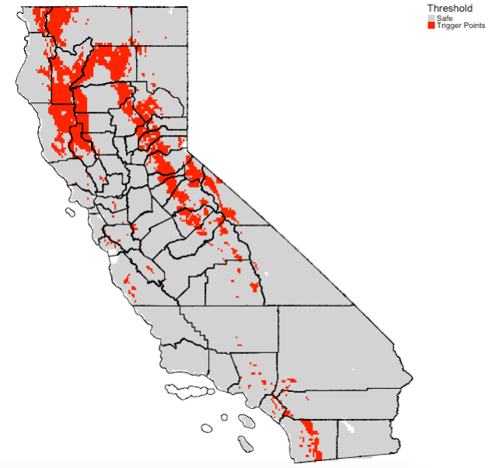
Result 2: Prediction of high-risk locations & where it is suitable (output is in gridded format)
We mapped predicted probability of fires using the trained model after making sure its valid. The multi-band raster is fed to the trained model to make full scale predictions.
This is based on the optimized estimate obtained after model validation i.e., maximizes the True Positive Rate and the True Negative Rate is 0.4054474 (40.55%). Here, we mapped predicted probability > 0.4054 as a reclassified raster.
38

Slide 39
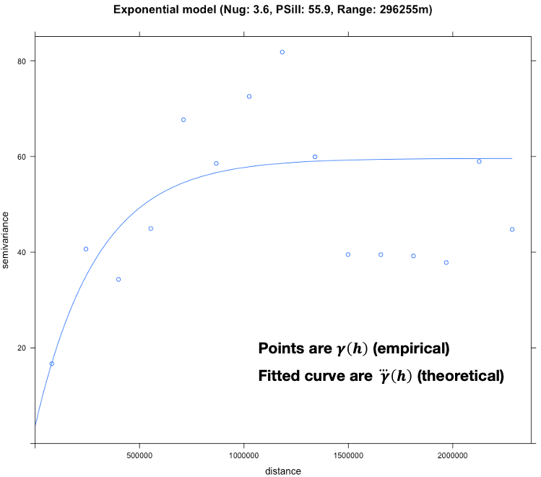
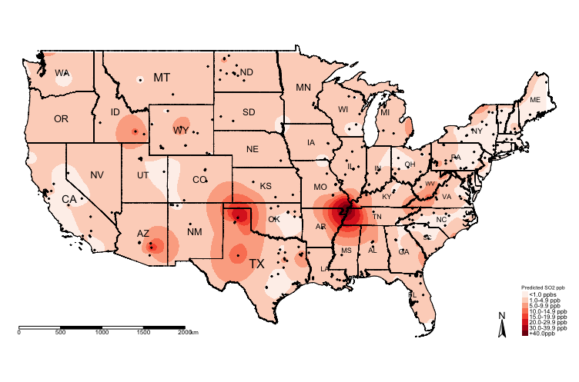
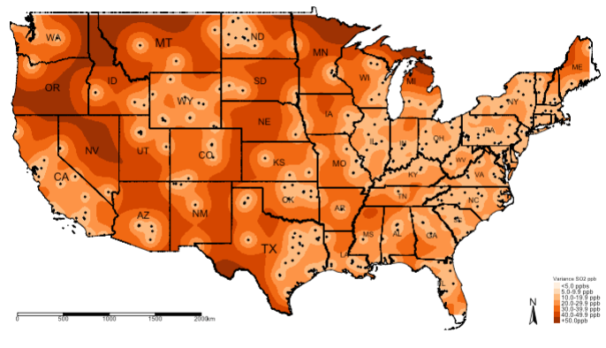
[4] Geostatistical Data: Kriging
Variogram analysis
Predicted air SO₂ level from the
Kriging model
Uncertainty for the predicted air SO₂
levels from the Kriging model
Interpretation: The nugget is a small value of 3.6, which is an indication for evidence of spatial variability in the concentrations for SO₂ across sampling sites in USA. The range is 296,255m, which indicates that any separation distance above this value means that spatial autocorrelation in the observed levels of SO₂ between points are no longer similar. However, points with a separation distance less than 296,255m indicated that their SO₂ values are similar. For the partial sill, within this range for the Semivariance i.e., 3.6 and 55.9 – is the values are spatially autocorrelated.
Along the belt of the following states – Missouri, Tennessee, Kentucky and Illinois, the predicted concentration of SO₂ levels exceeds +40ppb, whereas there are pockets in Texas where concentrations of SO₂ are a cause for concern i.e., 30-39.9ppb.
39

Slide 40
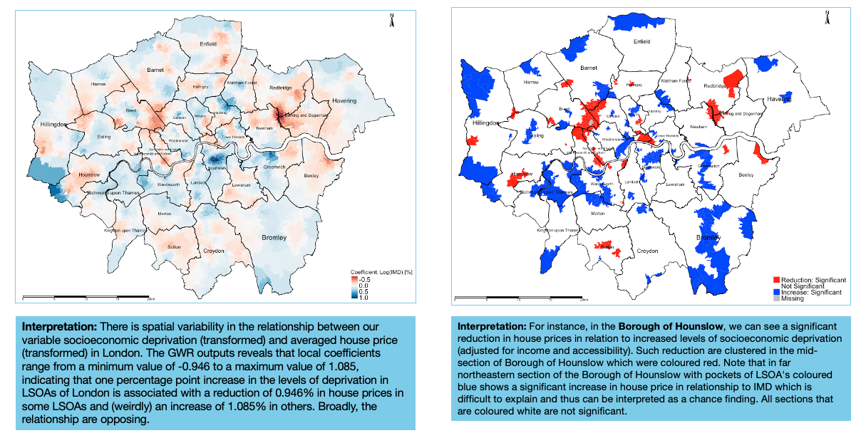
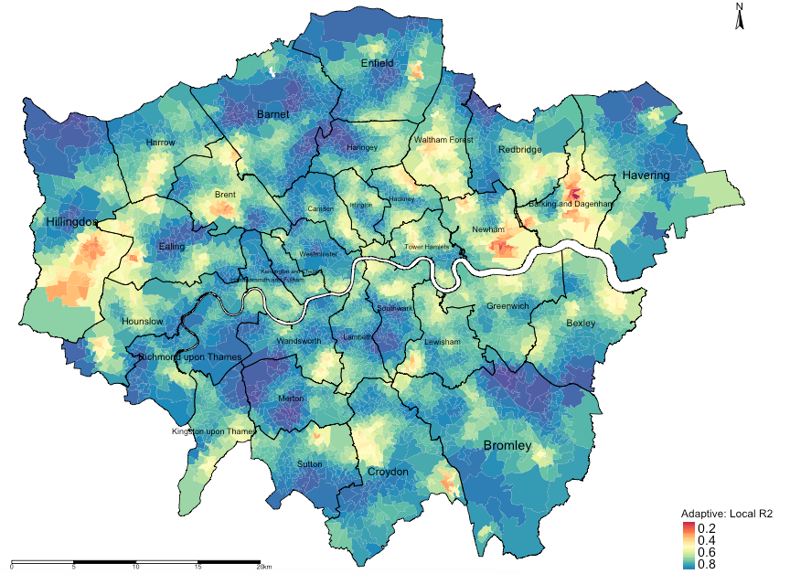
[5] Areal Data: Geographically Weighted Regression
[1] Local regression coefficients
[2] Statistical Significance
[3] Local R² : Model Diagnostics
Interpretation: The areas that are going towards the shade of dark reds (i.e., value of 0) are local regression models that have broadly performed poorly in its prediction for house price and its association with the three variables (income, deprivation and PTAL). Likewise, the areas that are going towards the shade of dark blues (i.e., value of 1) are local regression models that have broadly performed very well in its prediction for house price and its association with the three variables (income, deprivation and PTAL).
Note: These results are essential as the local R2 values of each area show the model’s ability to predict the explained variance in house prices caused by deprivation, income and accessibility for specific areas.
40

Slide 41
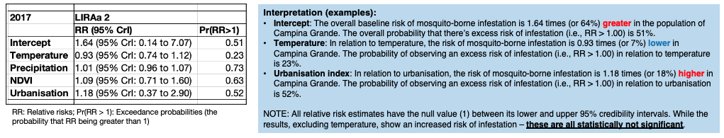
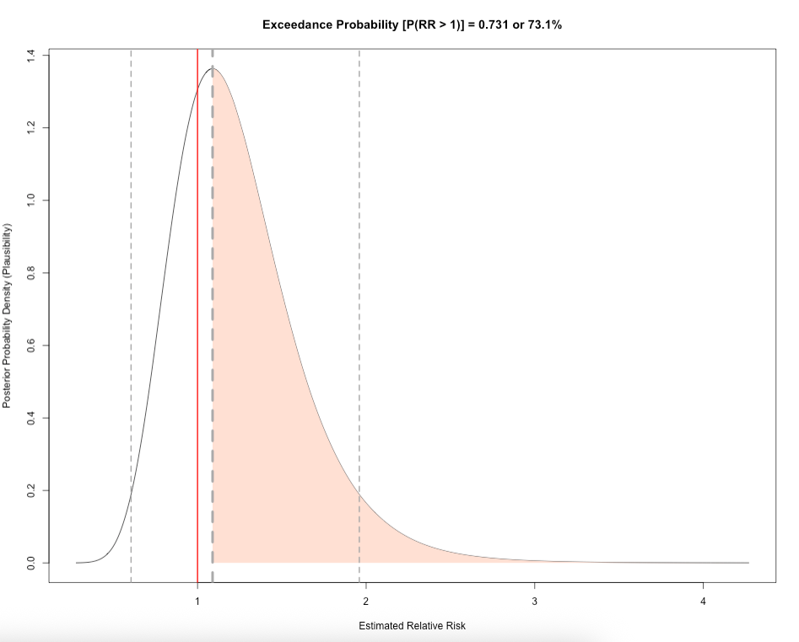
[6] Areal Data: Spatial Bayesian Models for Risk Assessment
Report the overall risk results
Describe the distribution of the relative risks
Here, in this distribution image, we show all the possible values of how temperature is related to mosquito infestation in terms of impact and risk given the dataset we have. The relative risk for mosquito infestation given temperature can be anywhere from 0.278 (reduced risk) to 4.271 (increased risk). But from the graph, it indicates that the most plausible relative risk estimate is 1.089 because it has the highest density in our posterior distribution.
To gauge levels of certainly about this estimated risk, we can calculate the probability that the relative risk is 1.089 or above. The probability of observing a relative risk of mosquito infestation being 1.089 or above, given the environmental levels of temperature, is 0.731 or 73.1%, which is quite high
41

Slide 42
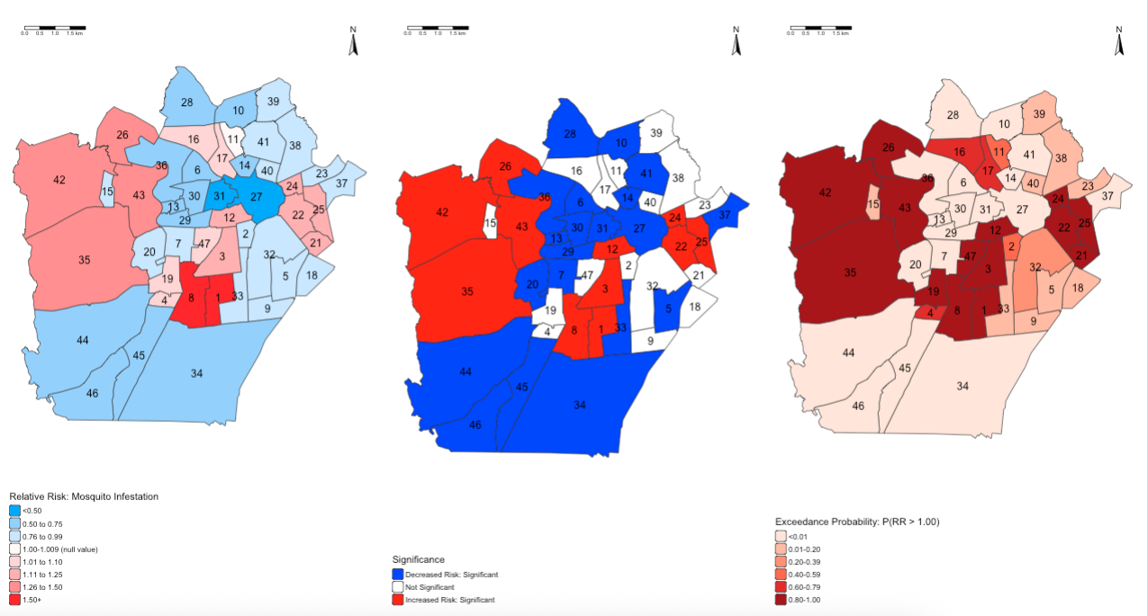
[1] Area-specific risks
[2] Statistical Significance
[3] Exceedance Probabilities
42

Slide 43
RStudio as a GIS Software
43

Slide 44








What is R/RStudio?
44

Slide 45
R (Standard)
RStudio (Best)
There are two version of the software: 1.) R, and 2.) RStudio; The second is much preferred as its straightforward and intuitive.
45

Slide 46

Why are we teaching RStudio?
Flexible and provides access to powerful packages for analysis
Impressive graphs, visualizations and maps
Excellent statistical capabilities too
Example: Map generated in R to illustrate areas that are environmentally suitable for the spread of neglected tropical disease called ‘Lymphatic Filariasis (LF)’ in Kenya.
Sources:
1. Global Atlas for Helminths Infection (http://www.thiswormyworld.org)
2. ESPEN (https://espen.afro.who.int)
46

Slide 47

… and why learn how to code in RStudio?
Efficiency
Automated tasks and data managing
Can recycle & reuse code scripts for new projects
2. Fosters good scientific practice
Transparency and replication (AKA reproducible research)
Creates log so anyone can follow in your footstep (i.e., github, gitlab etc.,)
You can literally pull-off some really creative stuff like generating websites, accessing tools via APIs etc.
Example: Working in RStudio and synchronising it with GitHub to not only use as a cloud back-up, but to generate a website through RStudio and GitHub for teaching MSc Students.
Sources:
GitHub (https://github.com)
47

Slide 48

Example of a basic code structure in RStudio
# comment: activate packages for performing GIS in R library("sf") library("tmap") # comment: add neighbourhood shapefile w/mosquito infestation data using read_sf() recife.neighbourhoods <- read_sf("Recife_neighb_epsg3857_fixed.shp") recife.healthzone <- read_sf("Recife_regions_epsg3857_fixed.shp") # comment: assigning labels for the risk estimate legends RiskCategorylist <- c(”\u2264 0.10", "0.11 to 0.25", "0.26 to 0.50", "0.51 to 0.75", "0.76 to 0.99",">1.00 to 1.09", "1.10 to 1.24", "1.25 to 1.49", "1.50 to 1.74", "1.75 to 1.99", "2.00 to 2.99", ”\u2265 3.00") # comment: generating the divergent color scheme from Blues to Red spectrum RRPalette <- c("#33a6fe", "#65bafe", "#98cffe", "#cbe6fe", "#dfeffe", "#fef9f9", "#fed5d5", "#feb1b1", "#fe8e8e", "#fe6a6a", "#fe4646", "#fe2424", "#fe0000") # comment: map of risk of infestation tm_shape(recife.neighbourhoods) + tm_fill("RelativeRiskCat", style = "cat", title = "Infestation Risk", palette = RRPalette, labels = RiskCategorylist) + tm_shape(recife.healthzone) + tm_polygons(alpha = 0, border.alpha = 0.90) + tm_layout(frame = TRUE, main.title = "Mosquito Infestation in Neighbourhoods (Brazil)", main.title.size = 0.8, main.title.position = 0.02, main.title.fontface = 2, legend.outside = TRUE, legend.outside.position = "right", legend.title.size = 0.8, legend.text.size = 0.7) + tm_scale_bar(position = c("left", "bottom")) + tm_compass(type = "radar", show.labels = 2, position = c("right", "top"))
48

Slide 49





Access to tomorrow’s practical session:
Recommended Books for learning Spatial Data Science
High recommendation for the coding experience and execution of spatial analysis in R
High recommendation for the mastery of basic theory and principles of spatial analysis
49
Notes:
These are my suggested books which I recommend

Slide 50
Any questions?
50

